Slide 1
Identifying Key Factors in
Drought Prediction
Nidhi Danayak
Image source: circleofblue.org

Slide 2
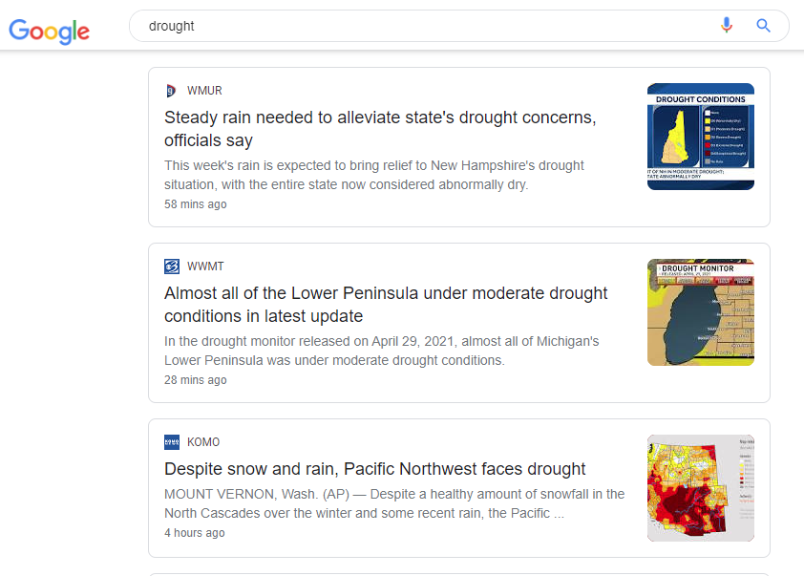
Who cares about drought?
US federal government about to issue first ever water shortage warning
Hoover dam won't be able to generate power
Plenty of historical data is available – can we use that data + predictive analytics to predict drought severity?
Image source: google.com

Slide 3
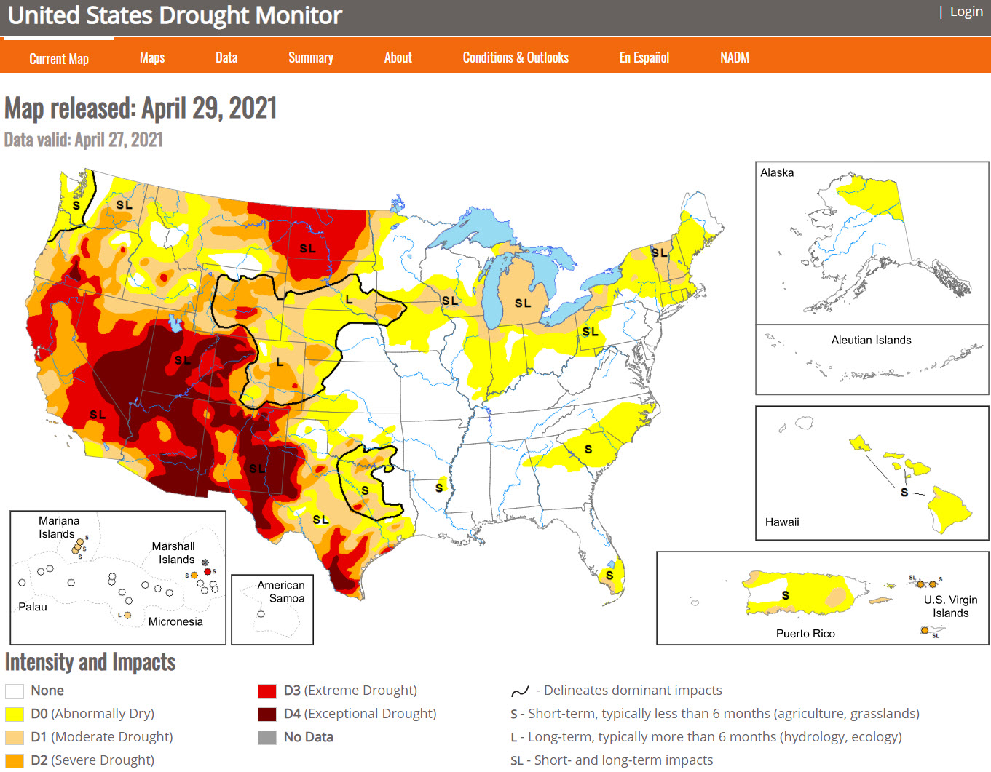
US Drought Monitor
joint production of various government agencies and educational institutions
provides historical weather and soil data, along with drought severity score
it's not a forecast
encourages public use of the data

Slide 4
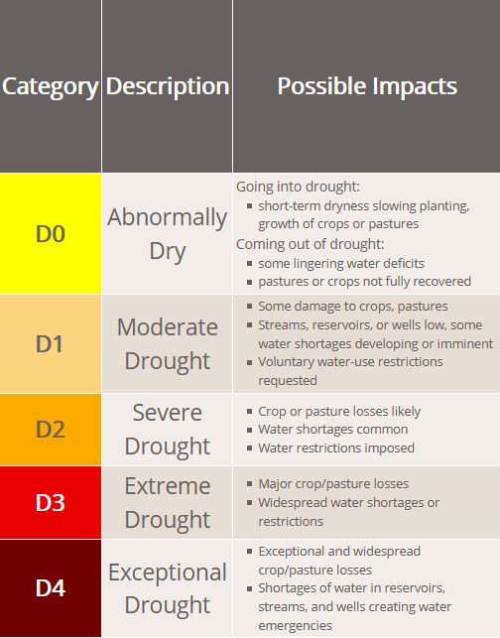
Data Collection
Context
Investigate if droughts could be predicted using only meteorological data, potentially leading to generalization of US predictions to other areas of the world.
Note: We removed "date" as a factor in order to focus on feature significance.
Content
A classification dataset over 5 levels of drought, pictured to the right.
Each entry is a drought level at a specific point in time in a specific US county, accompanied by the last 90 days of 18 meteorological indicators.
Split | Year Range (inclusive) | Percentage
Train | 2000-2009 | 47%
Validation | 2010-2011 | 10%
Test | 2012-2020 | 43%

Slide 5
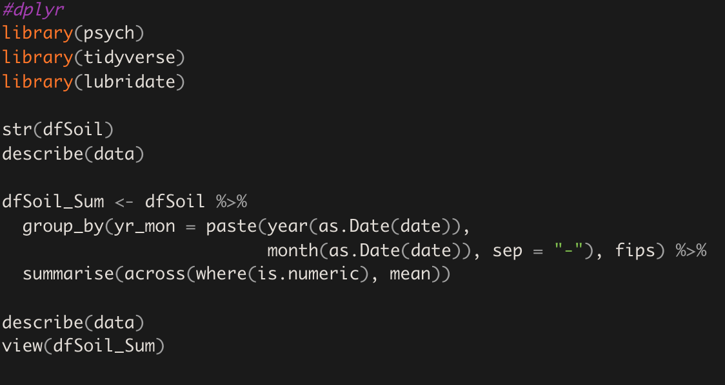
Large Dataset >2 GB Tools
Original Files (1 Record per Day per County)
Split | Records | Size (G)
Train | 19,300,681 | 2.1G
Validation | 2,268,841 | 246M
Test | 2,271,949 | 246M
After Dplyr Group by Year, and Month (2020-04)
Split | Records | Size (G)
Train | 634,033 | 83M
Validation | 74,593 | 9.8M
Test | 74,593 | 9.7M
https://dplyr.tidyverse.org/articles/colwise.html

Slide 6
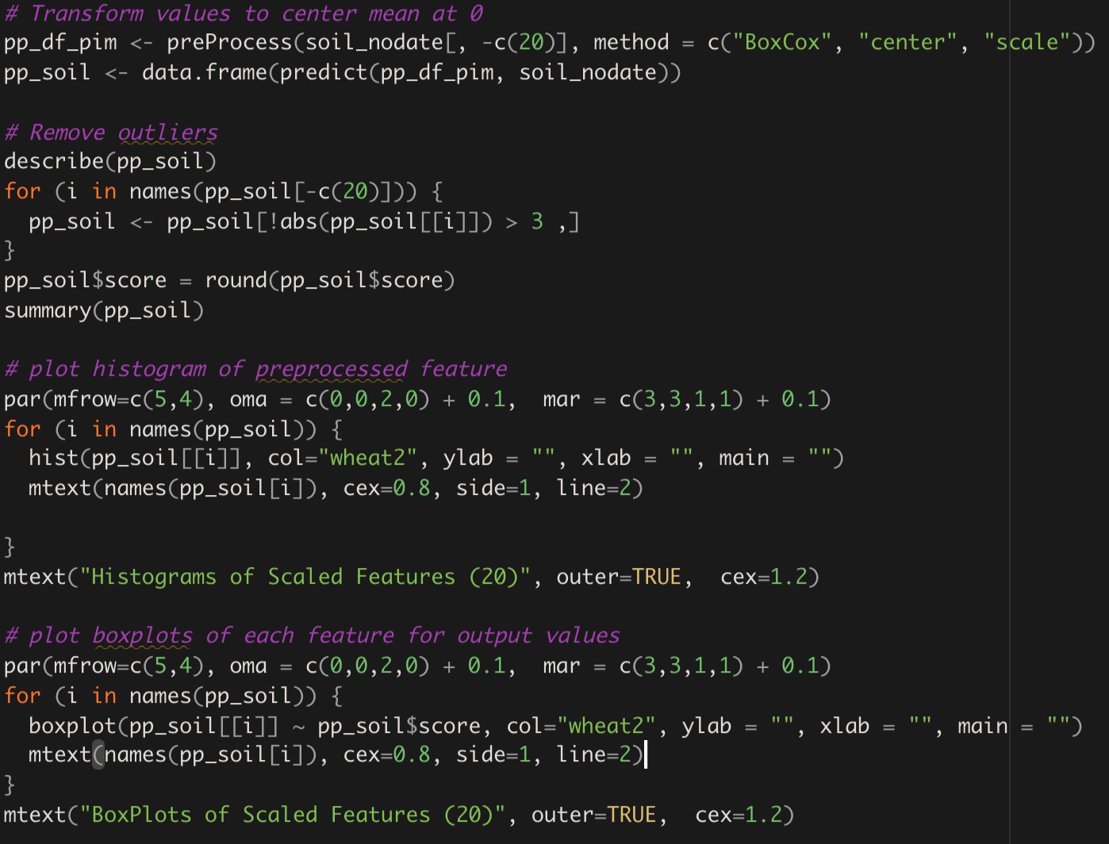
Data Preprocessing
Zero duplicates and Zero NAs
Center all features to a mean of 0
Remove Outliers > 3 Std. Dev.
Round Output-y (drought score)
Plot the histograms of each feature
Box plots of features for each score
We spent a significant amount of time "thinking" through our dataset and how we could compensate for the significant non-normalized (high skew) nature of the data set.
The final code on the right is the result of the relentless collaboration within our team!

Slide 7
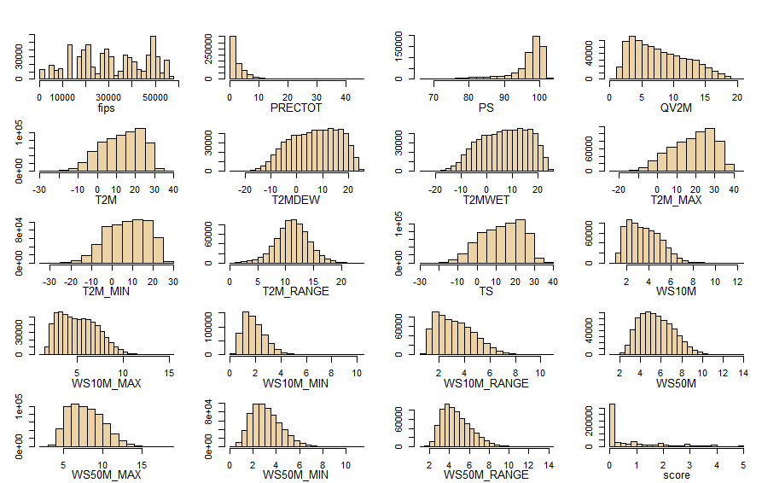
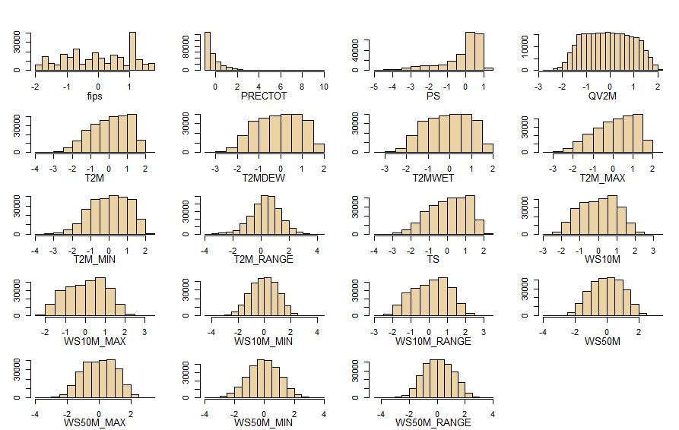
Data Preprocessing
Source Data
PreProcessed Data

Slide 8
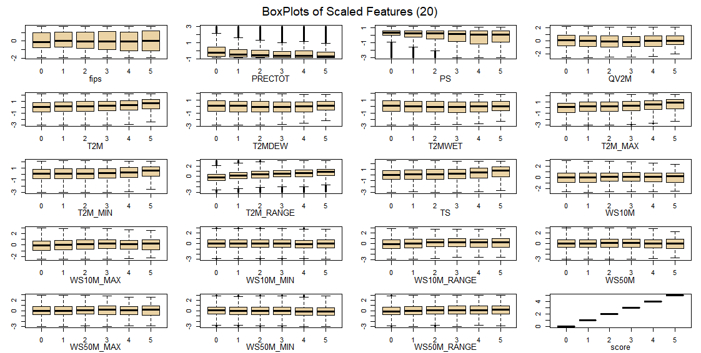
Data Preprocessing

Slide 9
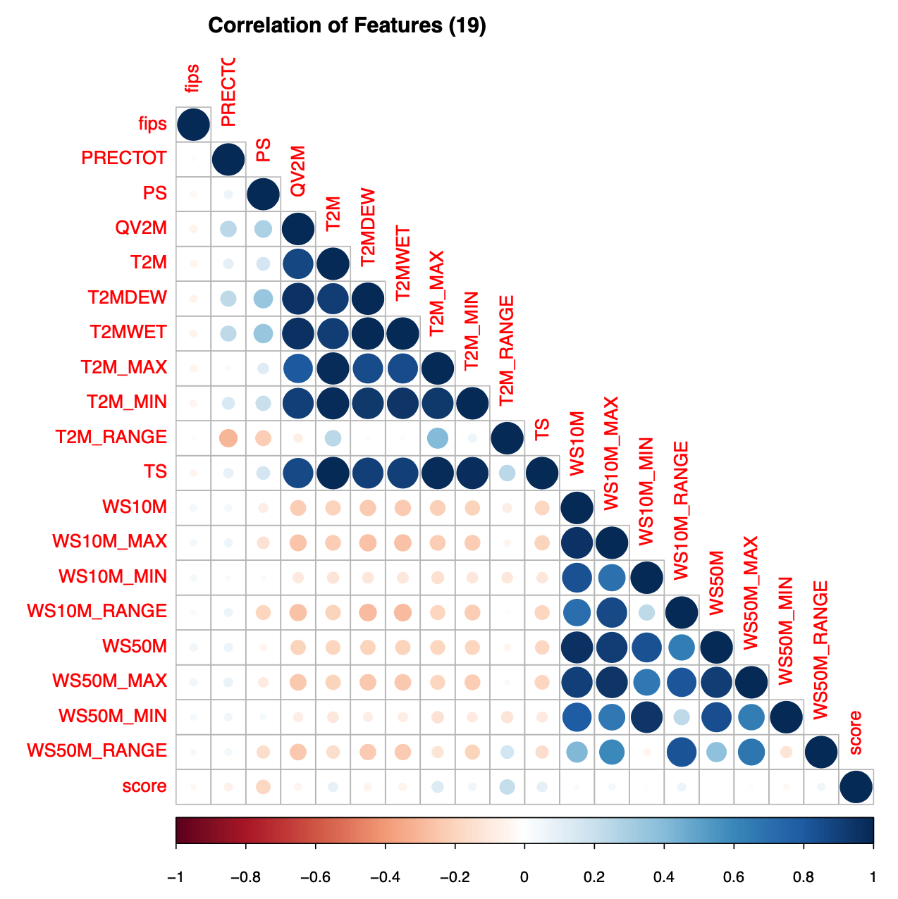
Methodology
Objective: Find which factors "most" influence drought score
Ordinal regression and multiple classification models provided the best means to determine possible relationships between weather data features and the severity score of drought.
We consciously excluded date from our analysis due to the large size of the dataset.
Unfortunately, as visible from our Corrplot only a few features had any correlation to drought score. We expand on this in our findings.

Slide 10

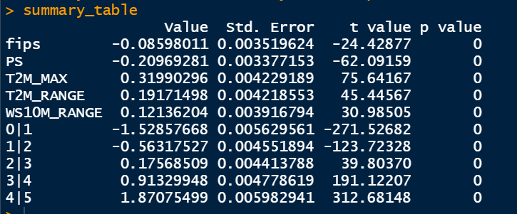
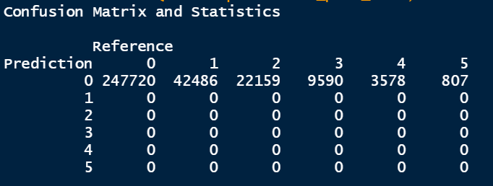
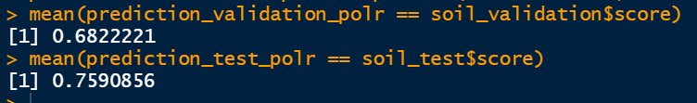
Models - Ordinal
This model gives good accuracy, but on further analyzing the confusion matrix we can conclude that it underperformed

Slide 11

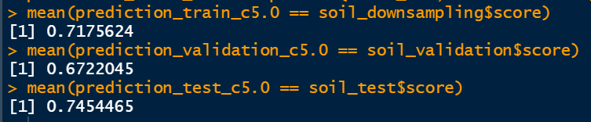
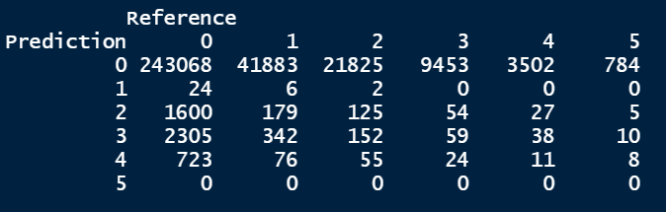
Models - C5.0
This model gives good accuracy and a much better classification matrix

Slide 12

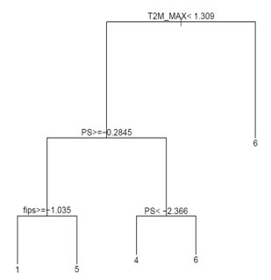
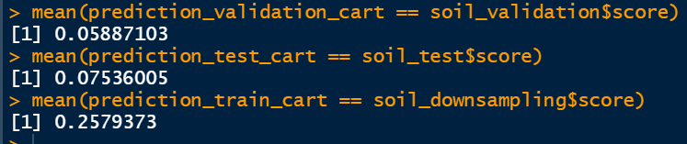
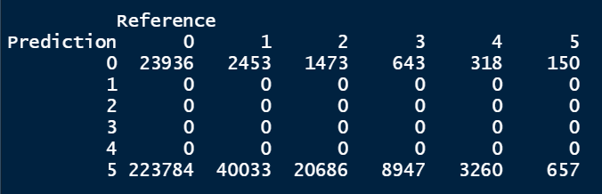
Models - RPART
CART underperformed tremendously in both accuracy and confusion matrix. But it gave us an in site on the major features driving the model's decision making

Slide 13
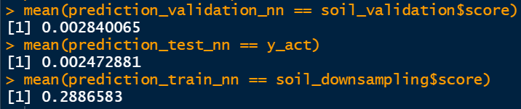
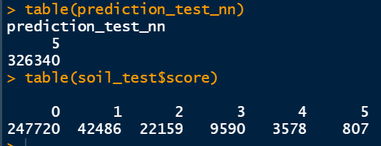
Models - NEURAL NET
Neural Network predicts everything in class 5 which show its underperformance despite its high power
We tried running the model with maximum iteration>=1000, but the high computational load of this model crashed our systems

Slide 14
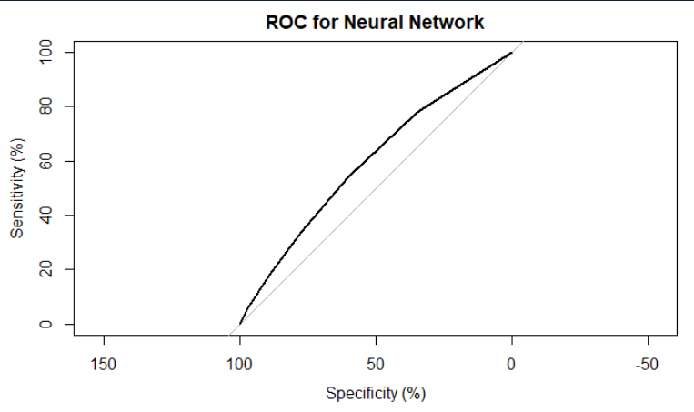
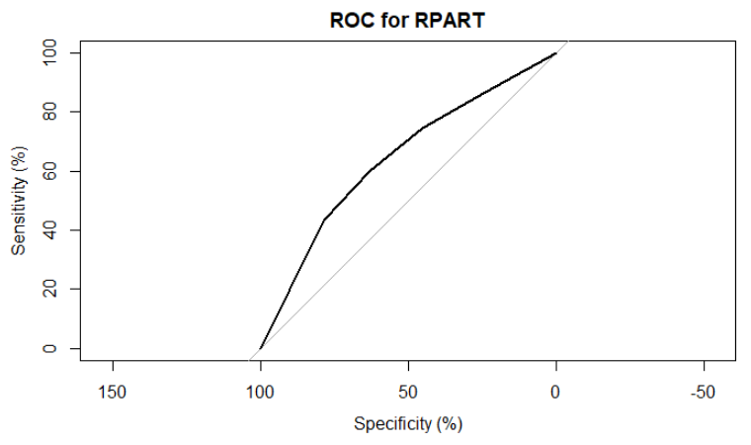
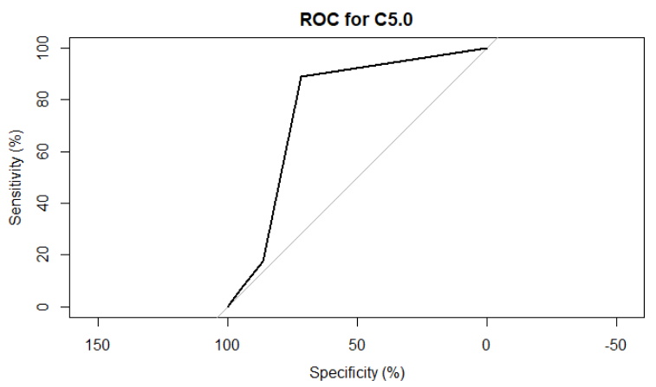



Evaluations – Performance – comparing

Slide 15
Outcomes/Finding
FEATURES | CORRELATION
fips | -0.05160543
Surface Pressure (kPa) | -0.16924778
Temperature at 2M | 0.1070144
Maximum Temperature at 2M | 0.15054281
T2M_RANGE | 0.24948646
Wind Speed Range at 10 Meters (m/s) | 0.11101822
Precipitation | -0.07166571
Specific Humidity 2m | -0.06784445
T2MDEW | -0.06591331
T2MWET | -0.0651899
T2M_MIN | 0.0716427
Earth Skin Temp (C) | 0.1175141
WS10M | 0.06639164
WS10M_MAX | 0.08847621
WS10M_MIN | 0.01140501
WS50M | 0.03063234
WS50M_MAX | 0.0577941
WS50M_MIN | -0.01900761
WS50M_RANGE | 0.09391972
score | 1
Data Preprocessing is a quintessential
Down sampling led to better model evaluation
Drought score could be seen dependent on Surface Pressure, Temperature, Wind Speed Range

Slide 16
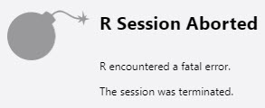
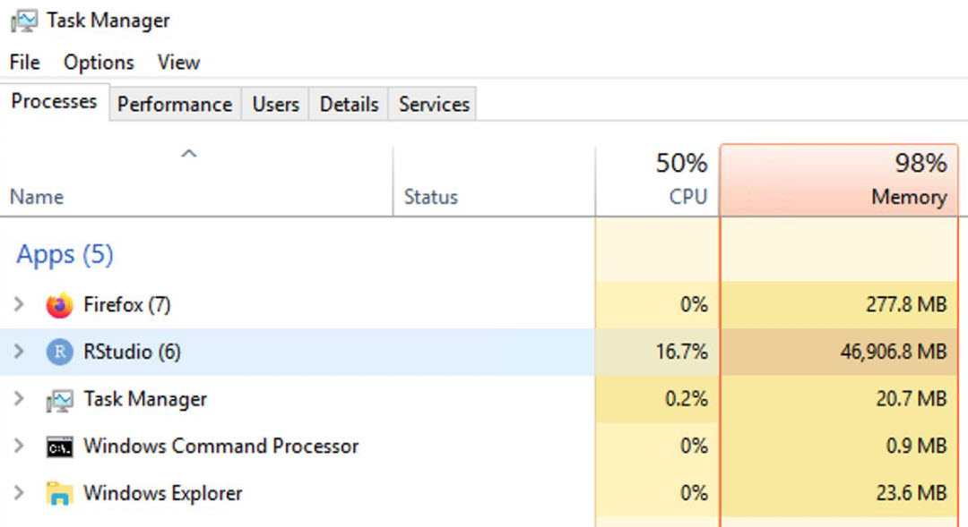
Lessons Learned and Perspectives
A lot of data and complex models take a lot of computing power in R
Large Dataset doesn’t necessarily give better model or high accuracy.
Correlation can be a useful metrics for better data modelling
Use Time Series Analysis for better exploration

Slide 17
Bibliographical References
United States Drought Monitor
https://droughtmonitor.unl.edu/
Predict Droughts using Weather & Soil Data
Kaggle data set by Christopher Minixhofer
https://www.kaggle.com/cdminix/us-drought-meteorological-data

Slide 18

Questions?

